Slide 1
STUDENT RENTAL HUB
Design and Development of a Full-Stack Peer-to-Peer Rental and Sharing System for College Students using the MERN Stack.
Team Members
person
Andrew John
B24CSB24
person
Goutham K C
B24CSB37
person
Harikesh A
B24CSB38
person
Irene Treessa Raj
B24CSB40

Slide 2
PROBLEM STATEMENT
02 / 12
payments
hub
gpp_bad
Financial Strain
College students frequently face high, non-recoverable upfront costs to buy essential resources like textbooks, lab tools, calculators, and bicycles.
These resources are typically required for only a single semester, making permanent purchases wasteful for tight student budgets.
No Centralized Hub
Generic public marketplaces are not optimized for low-value micro-rentals or short-term student lease periods.
Without a student-only platform, search is scattered randomly through unorganized WhatsApp or Telegram chats.
Trust & Safety Deficits
Existing public listing marketplaces lack verification gates, making students highly vulnerable to listing frauds and rental scams.
No secure, closed-loop platform dedicated exclusively to university verified student-to-student sharing exists.

Slide 3
PROJECT OBJECTIVES
03 / 12
shield
01
storefront
02
SECURE STUDENT VERIFICATION GATE
Restrict list creation and portal transactions solely to verified university students through institutional email validation (.edu / college email domains).
P2P SHARING & RENTAL MARKETPLACE
Establish an interactive, categorizable product catalog that facilitates textbook rentals, academic supplies sharing, and daily student utility hires.
payments
03
layers
04
TRANSACTION & BOOKING WORKFLOWS
Develop structured transaction mechanisms for tracking rental requests, lease terms, security deposits, and booking lifecycles.
MODERN FULL-STACK MERN SYSTEM
Deploy a responsive React interface driven by a secure Express/Node backend API, MongoDB database, and WebSockets (Socket.io) for instant negotiation.

Slide 4
SOCIAL RELEVANCE
04 / 12
savings
recycling
groups
Economic Affordability
Directly mitigates the rising costs of university living for low-income and budget-conscious college students.
By establishing a trusted peer-to-peer rental market, it ensures students rent textbooks and tools at a fraction of their purchase prices.
Circular Economy & Ecology
Supports campus sustainability by reducing consumer product waste and manufacturing demands.
Promotes the sharing, reuse, and recycling of textbooks, electronics, cycles, and student furniture within college hubs.
Peer Trust & Cooperation
Fosters a tight-knit campus community built on shared trust and peer-to-peer verification.
Enables collaborative consumption and mutual support, helping students network safely with peers and seniors.

Slide 5
REFERENCE & CLONING SITES
05 / 12
share
receipt_long
home
Fat Llama
REFERENCE MODEL
Peer-to-peer sharing marketplace for tools, cameras, and consumer goods.
CLONED WORKFLOWS
P2P owner listing registration.
Item location and radius search.
Safety deposit and rental protection model.
Rentomojo
REFERENCE MODEL
B2C electronic, furniture, and appliance subscription rental hub.
CLONED WORKFLOWS
Item search catalog with filters.
Subscription rental calendar picker.
Deposit calculation and checkout logic.
Airbnb
REFERENCE MODEL
Double-sided peer-to-peer hosting and booking engine.
CLONED WORKFLOWS
User review & ratings framework.
Provider vs. Renter split dashboards.
Internal inbox messaging structure.

Slide 6
EXPECTED OUTCOMES
06 / 12
devices
verified_user
forum
storefront
Responsive Web App
A fully functional MERN web app featuring responsive dashboards that allow users to list items, toggle availability, and manage active bookings.
Verification Gate
A secure login protocol powered by JWT ensuring only users with active, verified college email addresses can participate.
Negotiation Engine
An integrated WebSocket messenger that allows students to communicate, negotiate terms, and organize safe physical hand-offs in real-time.
Campus Marketplace
A centralized rental hub consolidating equipment lists, rental status tracking, security deposits, and messaging under one modern dashboard.

Slide 7
MAPPING WITH PROGRAM OUTCOMES (POS)
07 / 12
psychology
analytics
architecture
PO1: Engineering Knowledge
Applying core computer science and engineering specialization fundamentals to model database schemas (MongoDB) and construct secure API endpoints (Node/Express).
PO2: Problem Analysis
Identifying and formulating system requirements to resolve campus product sharing and rental challenges through a verified, centralized web application.
PO3: Design of Solutions
Designing secure components (JWT authorization gate, product catalog calendar, and Socket.io messaging) with appropriate consideration for user safety.
construction
groups
update
PO5: Engineering Tool Usage
Utilizing modern software engineering tools including the MERN Stack, VS Code, GitHub, Postman, and cloud environments to build robust workflows.
PO8: Collaborative Team Work
Functioning effectively in a 4-member team, dividing milestones across front-end, back-end, database schema design, testing, and project documentation.
PO11: Life-Long Learning
Engaging in self-directed learning of emerging full-stack paradigms, token authentication (JWT), and real-time WebSocket communication.

Slide 8
MAPPING WITH SDGS
08 / 12
school
lightbulb
recycling
SDG 4: Quality Education
Helps lower educational cost barriers by facilitating peer-to-peer sharing and rental of expensive academic books, calculators, and lab instruments.
This ensures students from underprivileged economic backgrounds have affordable, equal access to high-quality learning materials.
SDG 9: Industry & Infrastructure
Fosters technical innovation and resilient campus micro-infrastructures by designing a localized peer-to-peer digital sharing portal.
Establishes an effective model for small-scale item leasing, proving how digital solutions can streamline localized resource distribution.
SDG 12: Responsible Consumption
Promotes a circular sharing economy within university ecosystems that encourages renting and resource-sharing over buying new consumer goods.
Significantly reduces campus waste and carbon footprint, minimizing textbook e-waste and short-term consumer products.

Slide 9
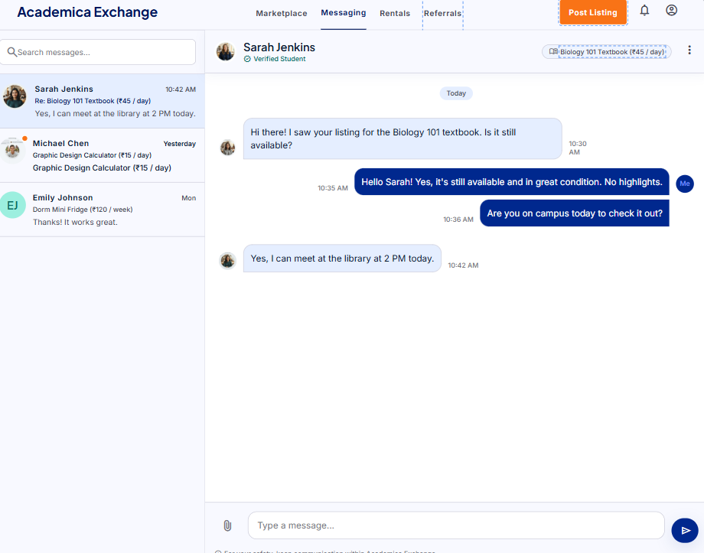
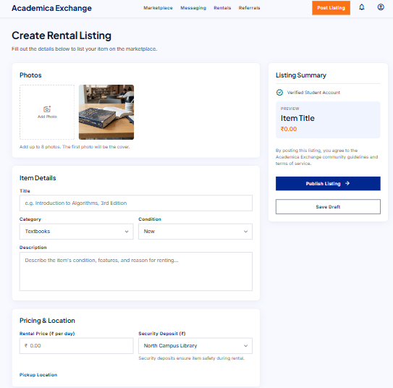

Slide 10
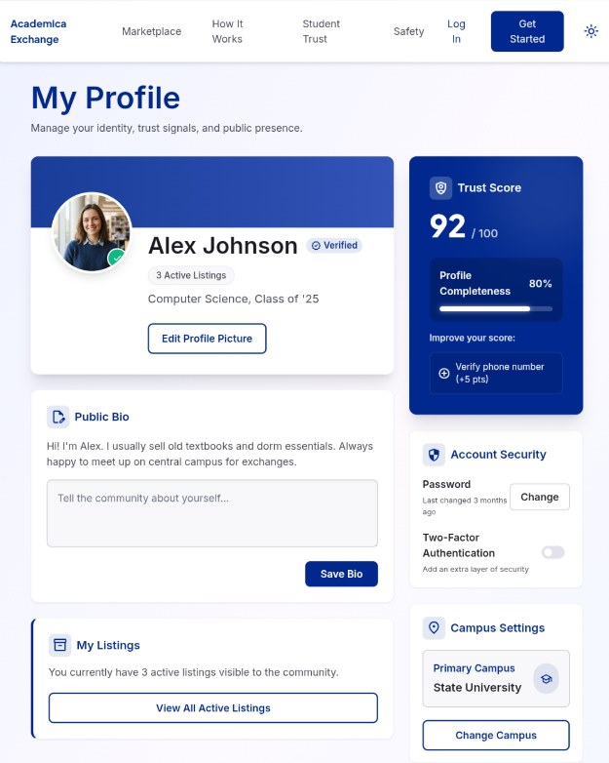
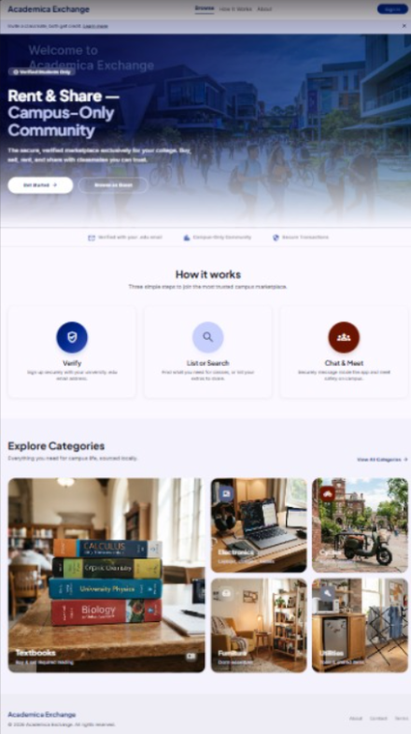

Slide 11

Frontend & User Interaction
11 / 12
JavaScript Coding & Dynamic UI
• Calculates rental prices, security deposits, and booking periods dynamically.
• Page interfaces update instantly without reloading to ensure a smooth, modern student experience.
• Safely manages user sessions, item lists, and active rental carts in browser memory.
Interactive Forms & Validation
• Checks password strength and form completion before allowing account registration.
• Enforces college verification gates by checking for valid student email domains.
• Dynamic booking calendars prevent students from booking overlapping rental dates.

Slide 12
Backend & Real-Time Systems
12 / 12
Database & Storage
• Stores structured collections for profiles, listings, and bookings.
• Custom filters retrieve items quickly based on campus tags.
• Links related records without creating duplicate profiles.
Real-Time Chat
• Runs full-duplex socket channels for instant peer message delivery.
• Shows typing state feedback and online status updates.
• Processes rental offers and meetup sites during live negotiations.
Architecture & Quality
• Segregates front and back systems to keep the files readable.
• Enforces strict code quality linters for clean compilation.
• Safeguards database stability with automatic standalone fallbacks.

